Slide 1
Generative AI for East Asian Studies: Use Cases

Slide 2
Basics
Create a new chat/Remove an old chat/Continue a previous chat
Continue
Copy

Slide 3
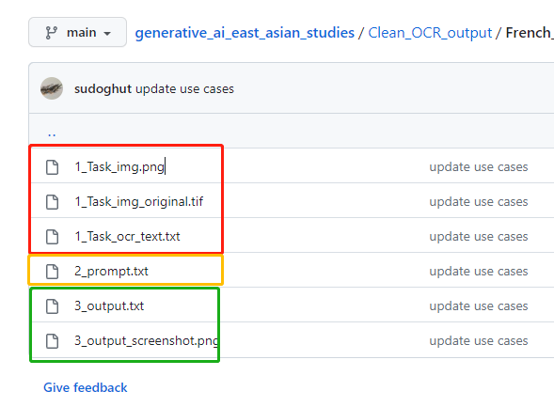
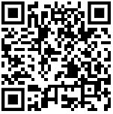
https://github.com/fccsdigitalchina/generative_ai_east_asian_studies

Slide 4
Use Cases
Create and Clean Data
Code (Standardize) Data
Data Analysis (Geocoding, Correlation)
Data Summarization
Data Visualization

Slide 5
Create and Clean Data

Slide 6
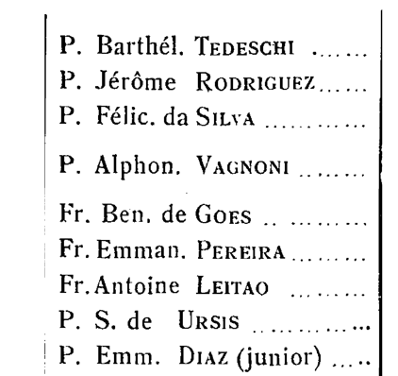
Create data from OCR
Notices Biographiques Et Bibliographiques Sur Les Jésuites de L‘ancienne Mission de Chine, 1552 – 1773
(Biographical And Bibliographical Notes On The Jesuits Of The Ancient Mission Of China, 1552 - 1773)
https://github.com/fccsdigitalchina/generative_ai_east_asian_studies/tree/main/Clean_OCR_output/French_names

Slide 7
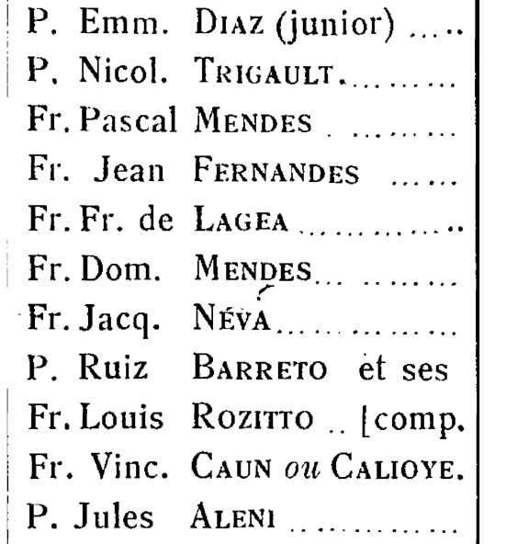
P. Emm. Diaz (junior) ..... P, Nicol. Trigault.
Fr. Pascal Mendes .
Fr. Jean Fernandes
Fr. Fr. de Lagea
Fr. Dom. Mendes
Fr. Jacq. Néva
P. Ruiz Barreto et ses Fr. Louis Rozitto .. [comp. Fr. Vinc. Caun om Calioye. P. Jules Aleni

Slide 8
Prompt: Description
I have a list of missionary names in French. They lived in 16c to 18c. please clean the data for me:
[your list]

Slide 9
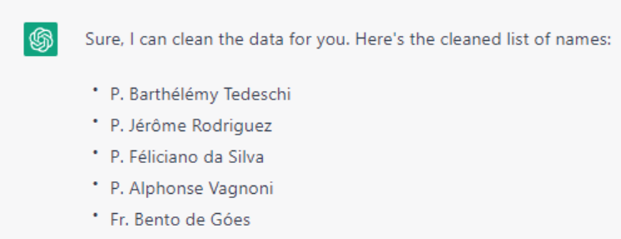
https://github.com/fccsdigitalchina/generative_ai_east_asian_studies/blob/main/Clean_OCR_output/French_names/2_prompt.txt

Slide 10
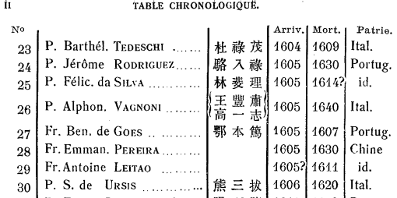
Create data from generative AI
https://github.com/fccsdigitalchina/generative_ai_east_asian_studies/tree/main/Data_generation/Generate_nationalities

Slide 11
Prompt: Description
I have a list of missionary names in French. They lived in 16c to 18c. please clean the data for me, and give them their birth year, death year, their Chinese names, nationalities and writings(multiple writings should be separated by ;)
Most the information can be found in this book: Pfister, L. . A. du texte. (1932). Notices biographiques et bibliographiques sur les Jésuites de l'ancienne Mission de Chine : 1552-1773. Tome II, XVIIIe siècle / par le P. Louis Pfister,... Chang-Hai.

Slide 12
Prompt: Output Schema and Define Batch Number
Generate 10 records per batch in this format:
|cleaned_name|cleaned_name_chn|birth_year|death_year|nationality|writings|
| -- | -- | -- | -- | -- | -- |

Slide 13
Prompt: Next Batch Trigger
Pause after generating each batch and wait for my input "continue" to generate the next batch.

Slide 14
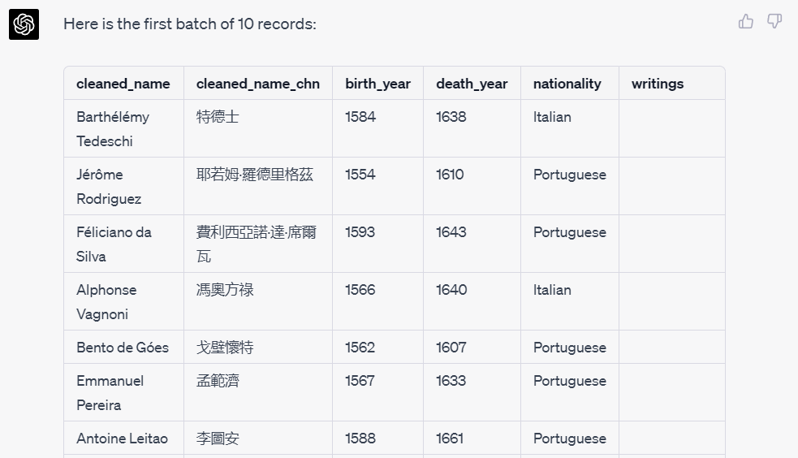
https://github.com/fccsdigitalchina/generative_ai_east_asian_studies/blob/main/Data_generation/Generate_nationalities/2_prompt.txt

Slide 15
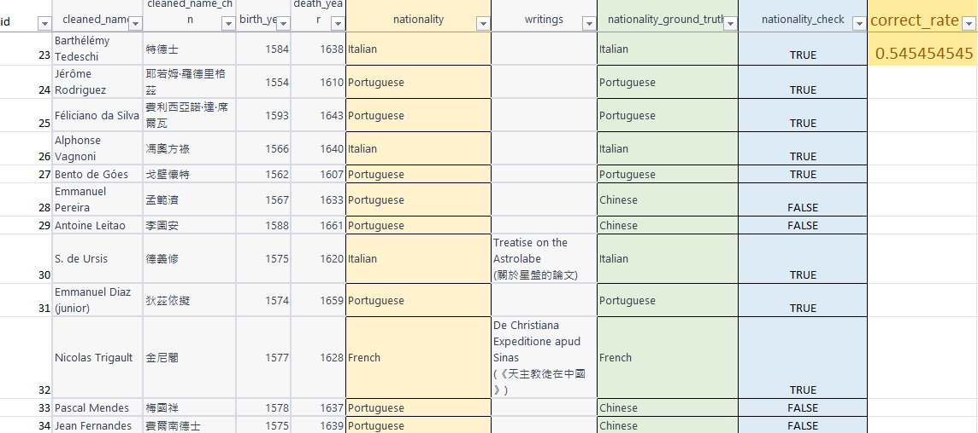
Correct Rate of Nationality (ChatGPT 4.0)

Slide 16
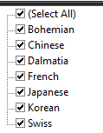
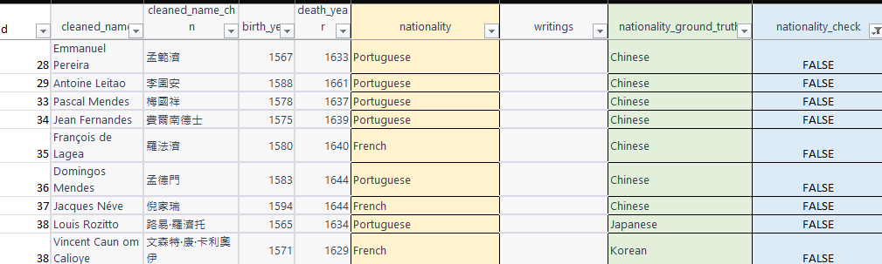
Observe the Data: False
https://github.com/fccsdigitalchina/generative_ai_east_asian_studies/blob/main/Information_generate/Generate_nationalities/3_output_check.xlsx

Slide 17
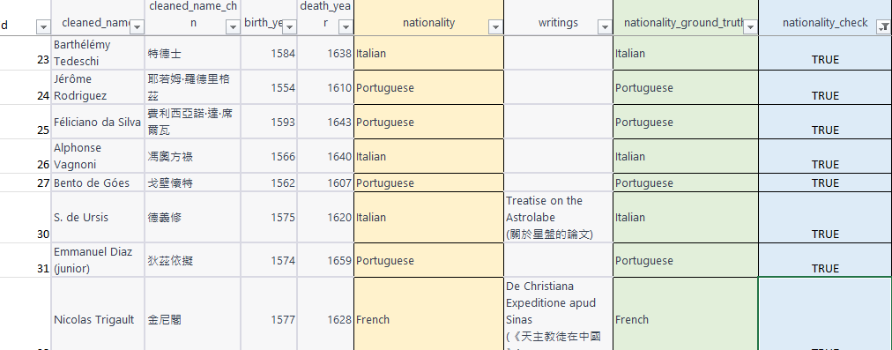
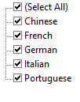
Observe the Data: True

Slide 18

Rearrange Data by Rules
安堅濟竇東德西相沙靜望民望我睹觀不
禮明範瑪安三方巴明居如華如迪瑪奇寧
范羅巴利麥孟石鍾黃郭蘇龍羅龐李費黎
From ABBYY
https://github.com/fccsdigitalchina/generative_ai_east_asian_studies/tree/main/Codes_generation/JavaScript/String_rearrangement

Slide 19
Solution: Generate some JS codes
JavaScript codes
=> Any Browser

Slide 20
Prompt 3.5: Describe the Pattern
I have a paragraphs. The length of this paragraph(p) can be divided by 3:
a1a2a3...anb1b2b3...bnc1c2c3... cn
I want to create a new 3 characters list(d) by using the corresponding vertical position of each paragraph. The order of picking characters will be from c1b1a1 to cnbnan.(the position of c1 is (length of p)/3*2, b1 is (length of p)/3, a1 is 0. Your loop length should be (the paragraph's length)/3). Your for loop step should be 1 instead of 3. The output should be(from left to right):
c1b1a1
c2b2a2
c3b3a3
...
cnbnan
安堅濟竇東德西相沙靜望民望我睹觀不
禮明範瑪安三方巴明居如華如迪瑪奇寧
范羅巴利麥孟石鍾黃郭蘇龍羅龐李費黎

Slide 21
Prompt 3.5: Describe your output schema
Each combination of d should be divided by a line breaker. Please provide a HTML file with inline CSS and JavaScript for a webpage that meets the following suggestions:

Slide 22
Prompt 3.5: Design the Output Layout
1. There is a input box on the page. Users will put a string like this in the input box "安堅濟竇東德西相沙靜望民望我睹觀不禮明範瑪安三方巴明居如華如迪瑪奇寧范羅巴利麥孟石鍾黃郭蘇龍羅龐李費黎". I'm also not sure how many characters each paragraph will have, but the length of the whole text is divisible by three

Slide 23
Prompt 3.5: Design the Output Layout
2. There is a button under the input box. It will trigger your js to convert the input to the output
3. Wrap the output to a <div> under the button
Notes: <div> tag in html stands for division

Slide 24
Prompt 3.5: Prettify Your Layout
4. This webpage should have a Disney style

Slide 25
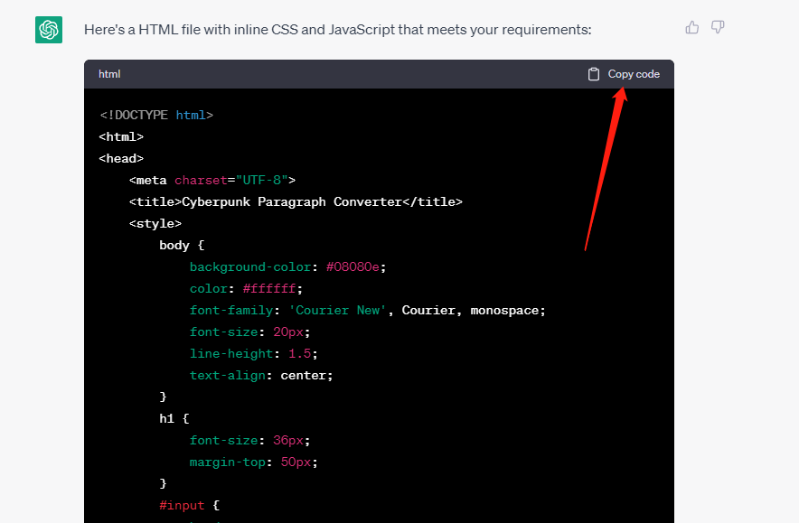
https://github.com/fccsdigitalchina/generative_ai_east_asian_studies/blob/main/Codes_generation/JavaScript/String_rearrangement/2_prompt_3.5.txt

Slide 26
Open your text editor(Ex. TextEdit on Mac, Notepad on Windows, VS Code, EmEditor, Notepad++…)
Paste the codes that you generated to your text editor
Save it as “xxxx.html”
Double click your page

Slide 27
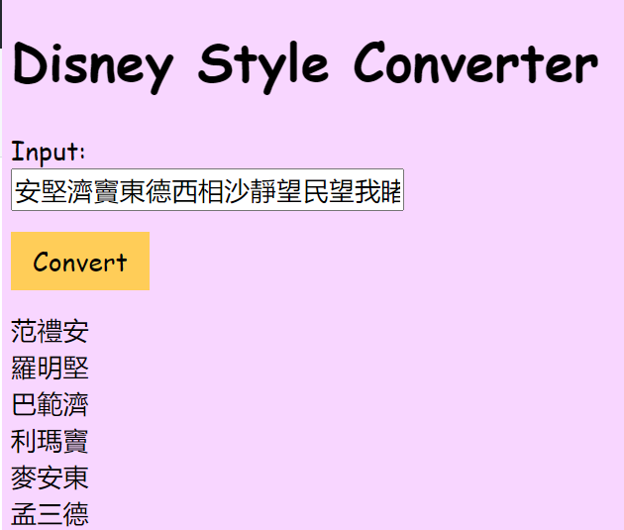
https://github.com/fccsdigitalchina/generative_ai_east_asian_studies/blob/main/Codes_generation/JavaScript/String_rearrangement/1_task.txt

Slide 28
Prompt 4.0: Describe Your Requirement
I have a paragraph. The length of this paragraph(p) can be divided by 3:
安堅濟竇東德西相沙靜望民望我睹觀不禮明範瑪安三方巴明居如華如迪瑪奇寧范羅巴利麥孟石鍾黃郭蘇龍羅龐李費黎
I want to create a new 3 characters list(d) by using the corresponding vertical position of each paragraph. The output should be:
范禮安
羅明堅
巴範濟
利瑪竇
...
黎寧不
https://github.com/fccsdigitalchina/generative_ai_east_asian_studies/blob/main/Codes_generation/JavaScript/String_rearrangement/2_prompt_4.0.txt

Slide 29
Code (Standardize) Data

Slide 30
Tag Social Associations (For 4.0)
【徐几】，字字与，号进斋，崇安人。博通经史，尤精于易。景定间与【何基】同以布衣召补迪功郎，添差建宁府教授，兼建安书院山长，撰经义以训式多士。
【林灵素】，字通叟，永嘉人。七岁能诗，日记累万言。【苏轼】一见惊曰：「子颖异非常，青紫可立待。」灵素笑曰：「生封侯，死立庙，非予志也。」去为道士，善妖幻，以方术得幸徽宗，赐号玄妙先生，惑众僭妄，众皆怨之。在京四年，恣横不悛，斥还故里死。
https://github.com/fccsdigitalchina/generative_ai_east_asian_studies/tree/main/Tag_data/Tag_social_assocations

Slide 31
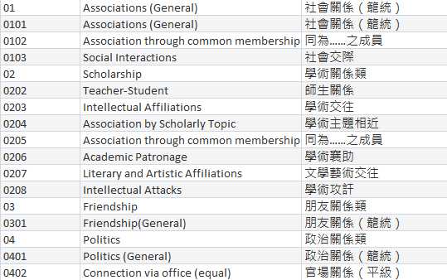
CBDB Association Model (45 types)

Slide 32
Prompt: Describe Data Model with Details
I have the following social association types:
c_assoc_type_id c_assoc_type_desc c_assoc_type_desc_chn
01 Associations (General) 社會關係（籠統）
0101 Associations (General) 社會關係（籠統）
Association through common membership 同為……之成員
…

Slide 33
Prompt: Design Output Requirement
After you read a paragraph(para), please tell me the social association code for them. Don't use any knowledge outside of the para. The information that you need to capture to identify the social association but will be very close to the persons' name.

Slide 34
Prompt: Design Output Schema
The paragraph is classical Chinese. The output schema should be a table like this:
|person 1|person 2|assoc_code|assoc|assoc_chn|positive/negative relationship|
| -- | -- | -- | -- | -- | -- |
|a|b|c_assoc_type_id|c_assoc_type_desc|c_assoc_type_desc_chn|positive/negative|
Reason:
[You will put your reason for choosing this association type here]

Slide 35
Prompt: Create an Interface (Input Format)
Now:
a is 徐几
b is 何基
para is:
【徐几】，字字与，号进斋，崇安人。博通经史，尤精于易。景定间与【何基】同以布衣召补迪功郎，添差建宁府教授，兼建安书院山长，撰经义以训式多士。

Slide 36
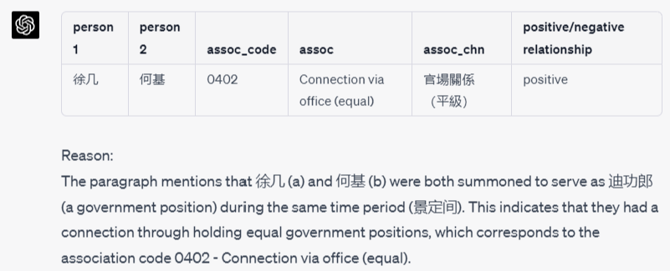
https://github.com/fccsdigitalchina/generative_ai_east_asian_studies/blob/main/Tag_data/Tag_social_assocations/2_prompt.txt

Slide 37
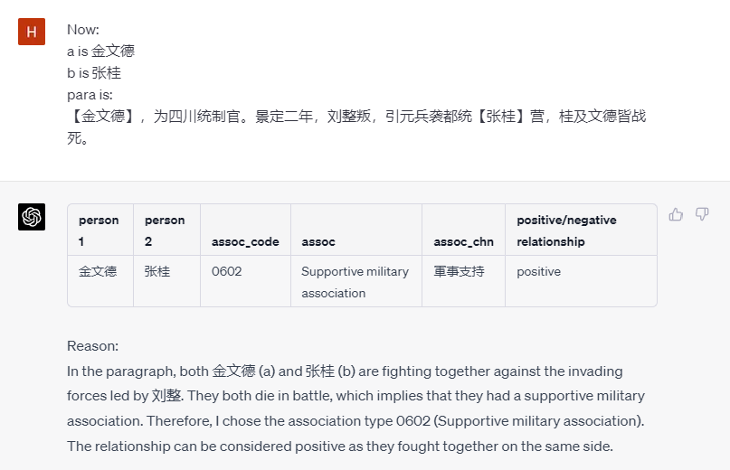
Prompt: Use the Interface

Slide 38
Convert Reign Year to Western Year (Training data)
慶曆二年
應順元年
崇寧四年
景祐二年
建中靖國元年
顯德元年
同光四年
….
https://github.com/fccsdigitalchina/generative_ai_east_asian_studies/tree/main/Training_data/Reign_year

Slide 39
Prompt 4.0: Describe Your Request
Output the western year from this Chinese reign year information. Don't use any knowledge beyond the information in the table below. There are no typos in the questions.
[Reign year list]

Slide 40
Prompt: Define Output Schema
The output should be a table like this:
| input | output |
| -- | -- |

Slide 41
Prompt: Submit Your Training Data
This is the table for your conversion
c_dynasty_chn c_nianhao_chn c_firstyear c_lastyear
隋 大業 605 617
隋 義寧 617 618
唐 武德 618 626
鄭（王世充） 開明 619 621
…

Slide 42
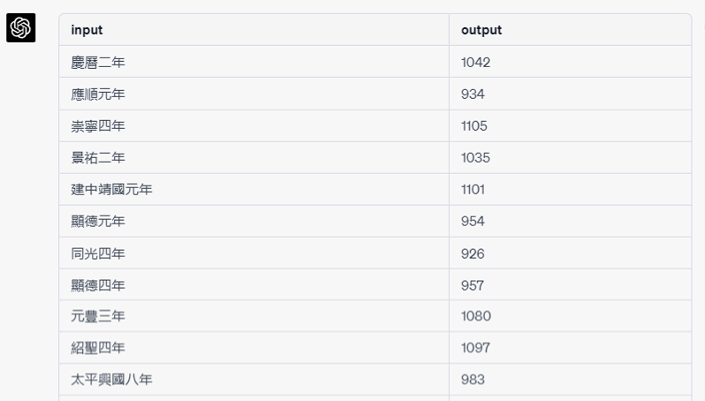
https://github.com/fccsdigitalchina/generative_ai_east_asian_studies/blob/main/Training_data/Reign_year/2_prompt_4.0.txt

Slide 43
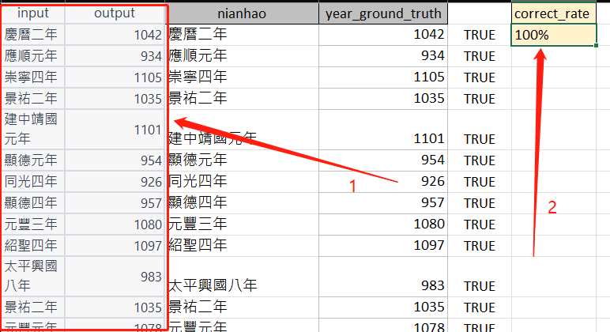
Check the results
https://github.com/fccsdigitalchina/generative_ai_east_asian_studies/blob/main/Training_data/Reign_year/3_output_reign_year_test.xlsx

Slide 44
Harvard LoGaRT
https://logart.fairbank.fas.harvard.edu/LGServices/

Slide 45
Create bibliography
I have seen a calligraphy in CBDB office(1737 Cambridge Street, K304, MA, 02137, USA) today. The author is unknown. I do not know the exact date. I just know the era this calligraphy is after 2000 . I want to cite it in my dissertation. Based on Chicago Manual of Style, how can I cite it？
https://github.com/fccsdigitalchina/generative_ai_east_asian_studies/tree/main/Bibliography_footnote/Calligraphy

Slide 46
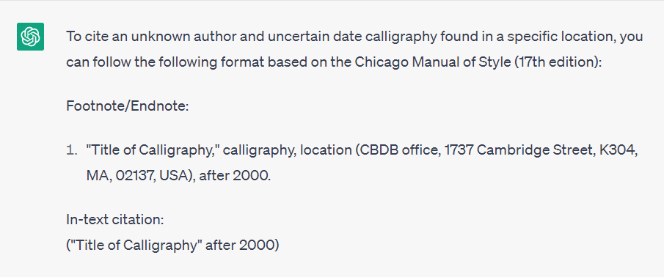
https://github.com/fccsdigitalchina/generative_ai_east_asian_studies/blob/main/Bibliography_footnote/Calligraphy/2_prompt.txt

Slide 47
Data Analysis (Geocoding, Correlation)

Slide 48
Find the biographical Addresses for some historical figures and put them on a map

Slide 49
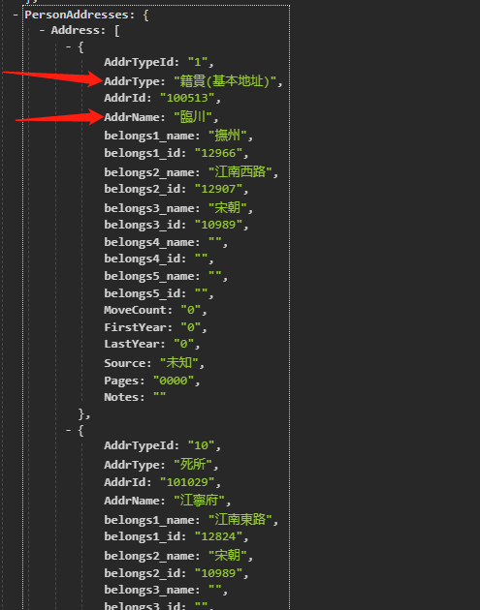
Call API and Parse JSON
https://cbdb.fas.harvard.edu/cbdbapi/person.php?name=%E7%8E%8B%E5%AE%89%E7%9F%B3&o=json
-Package
-PersonAuthority
-PersonInfo
-Person
-PersonAddresses
-Address

Slide 50
Prompt: Describe Your Task Briefly
Here is CBDB API:
https://cbdb.fas.harvard.edu/cbdbapi/person.php?id={personid}&o=json
I have a list of personid
[Person ID List]
please write python codes to query CBDB APIs by these personids separately.
Query interval is 0.5s

Slide 51
Prompt 3.5: Describe API Schema
Please find the Address node(Package-PersonAuthority-PersonInfo-Person-PersonAddresses-Address) that AddrType: "籍貫(基本地址)", get the corresponding AddrName.
The Address node in the CBDB API response might contain a single address element, in which case it is represented as a dictionary, but it might also contain multiple address elements, it is represented as a list of dictionaries.

Slide 52
Prompt: Define Output Schema
Put all the personid and AddrName together, and print it as
personid AddrName

Slide 53
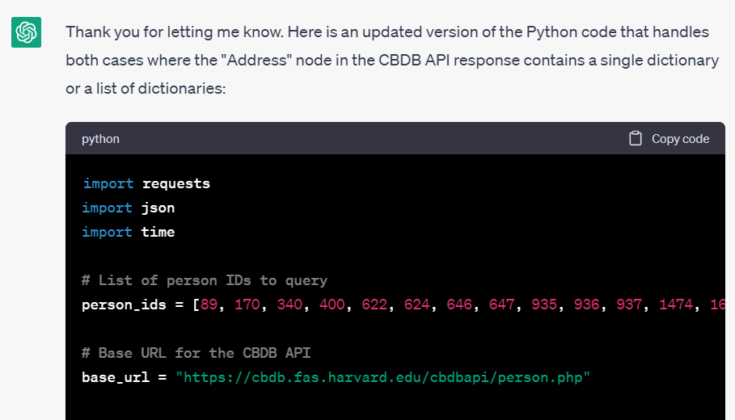
https://github.com/fccsdigitalchina/generative_ai_east_asian_studies/blob/main/GIS/Viz_cbdb_biographical_addresses/2_prompt_1_call_api_find_nodes.txt

Slide 54
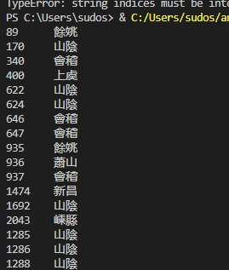
89 餘姚
170 山陰
340 會稽
400 上虞
622 山陰
624 山陰
646 會稽
647 會稽
935 餘姚
936 蕭山
937 會稽
1474 新昌
1692 山陰
2043 嵊縣
1285 山陰
1286 山陰
1288 山陰

Slide 55
Remove ID Column

Slide 56
Prompt
I have a table with 2 columns with header. Can you output a table without a header (don't output codes for programming language) that only include the AddrName column
personid AddrName

Slide 57
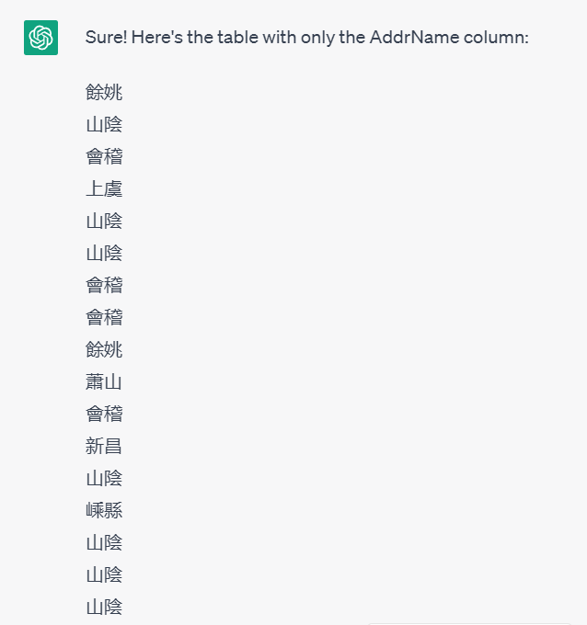
https://github.com/fccsdigitalchina/generative_ai_east_asian_studies/blob/main/GIS/Viz_cbdb_biographical_addresses/2_prompt_2_remove_column.txt

Slide 58
Geocoding Addresses

Slide 59
Prompt: Define Input and Output
This is the list of Zhejiang addresses in historical Chinese studies. Can you give me the approximate information for each address, and count how many times an address appeared in the list below:
[Address list]
The output should be a table like this:
id, name, x, y, count

Slide 60
Prompt: For Geocoding
The most important thing: I know these coordinates are approximate and ambiguous. Please just let me know your approximate information. These are just for reference.

Slide 61
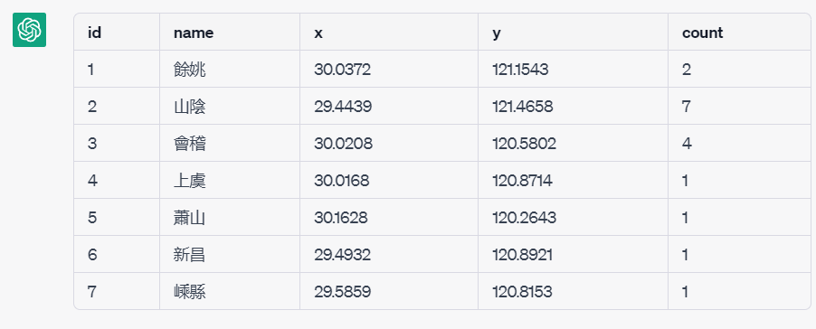
https://github.com/fccsdigitalchina/generative_ai_east_asian_studies/blob/main/GIS/Viz_cbdb_biographical_addresses/2_prompt_3_geocoding.txt

Slide 62
Visualize Addresses by Google Earth
Put the information from the list above into a schema like this with count information:<?xml version="1.0" encoding="UTF-8"?>
<kml xmlns="http://www.opengis.net/kml/2.2"></kml>

Slide 63
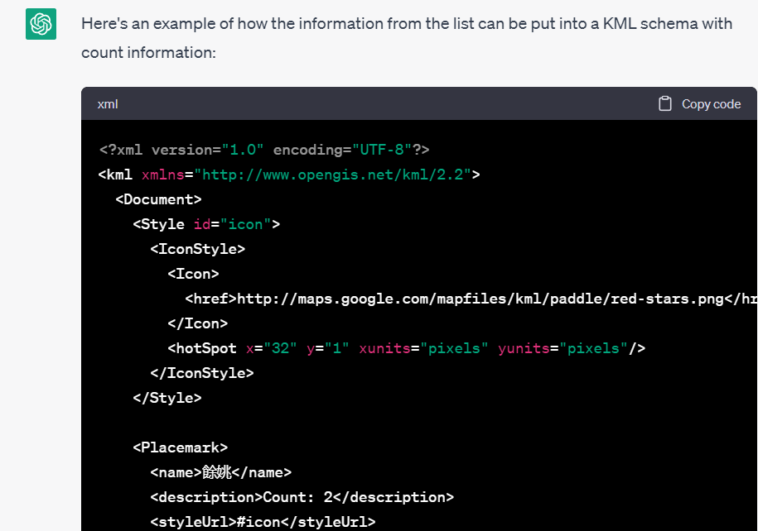
https://github.com/fccsdigitalchina/generative_ai_east_asian_studies/blob/main/GIS/Viz_cbdb_biographical_addresses/2_prompt_4_create_file_from_GIS_platform.txt

Slide 64
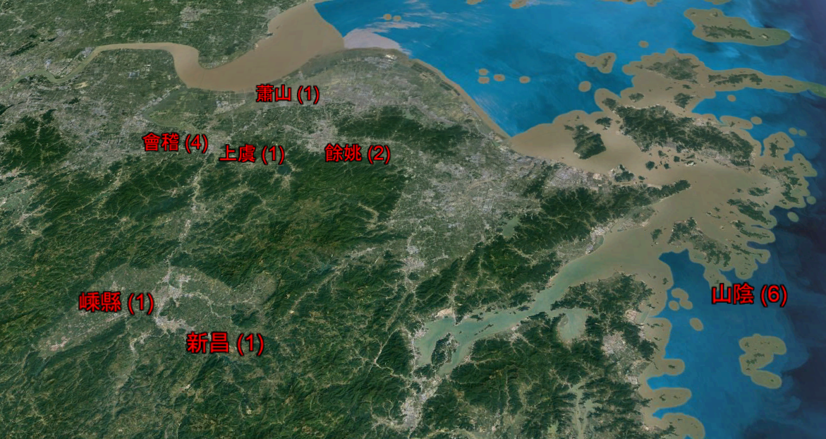

Slide 65
Summarize Articles

Slide 66

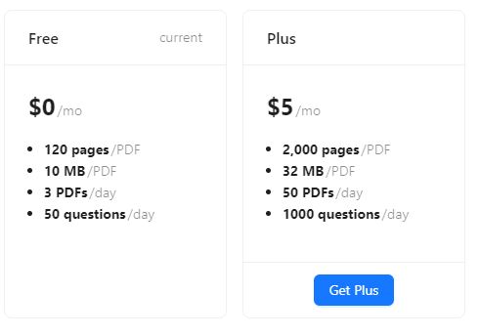
https://www.chatpdf.com

Slide 67
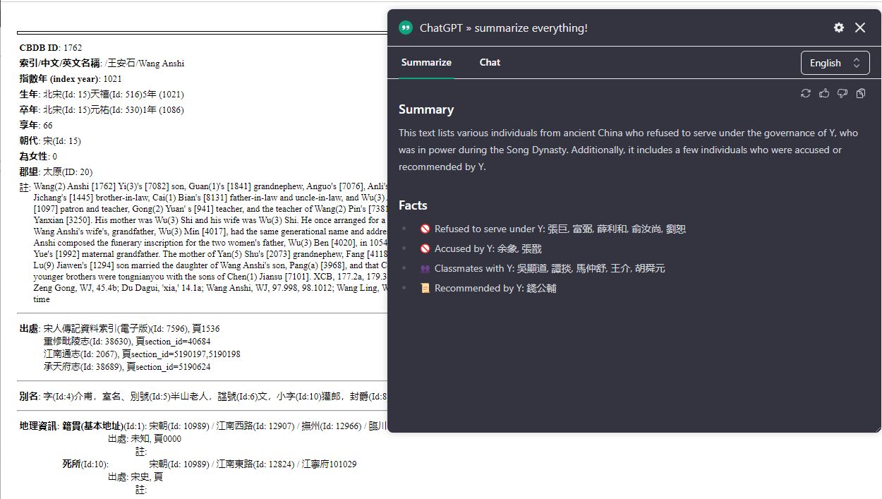
ChatGPT » summarize everything! – Chrome Plugin

Slide 68
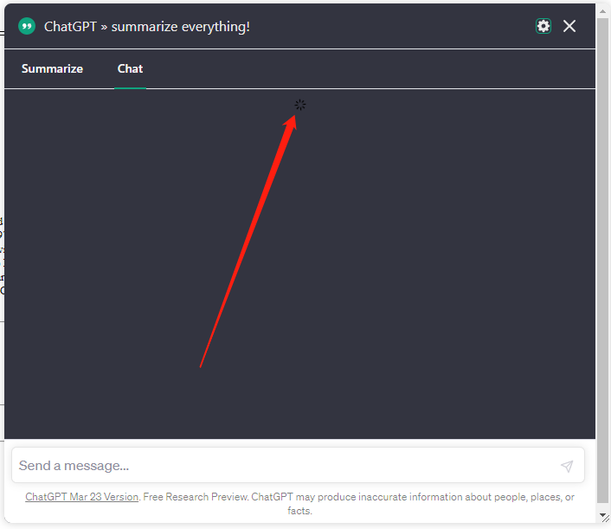

Slide 69
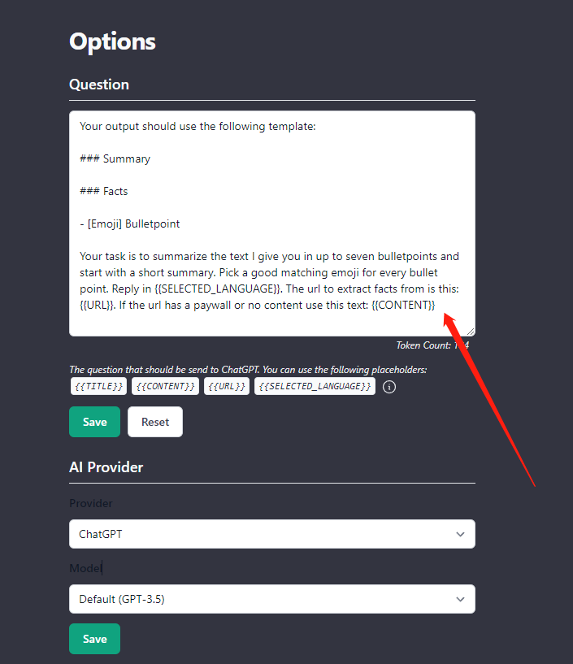

Slide 70
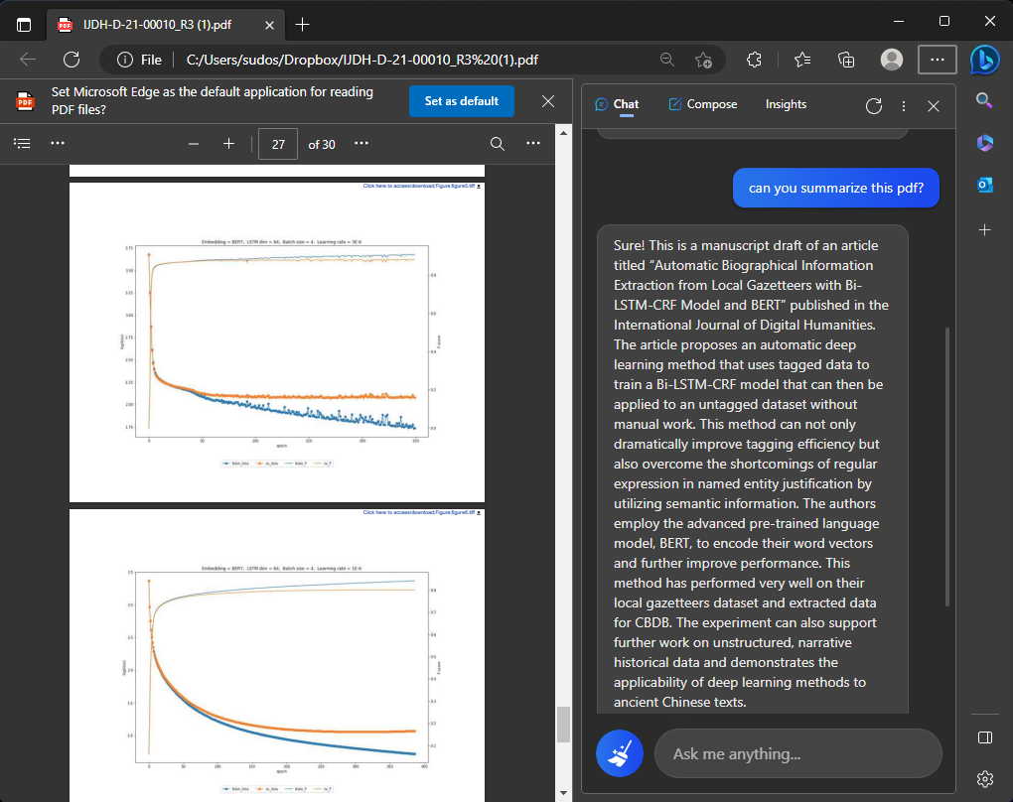
Edge: Web page, PDF

Slide 71
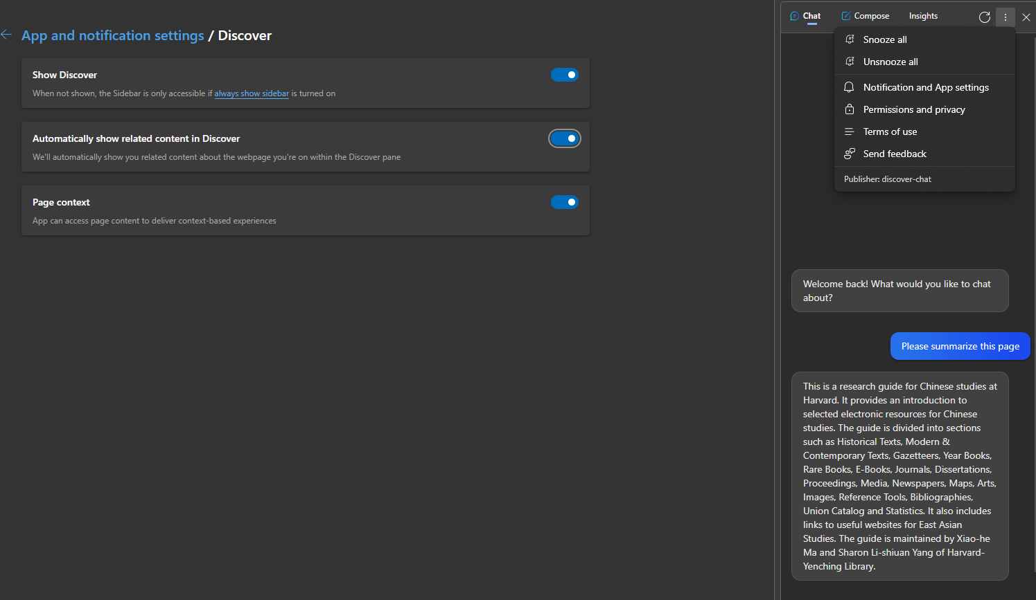


Slide 72
Reviews on AI Summarizations
Professor Peter Bol (Chinese Studies)
Doctor Katherine Matsuura (Japanese Studies)
Professor Si Nae Park (Korean Studies)
Professor Michael Szonyi (Chinese Studies)

Slide 73
Data Visualization

Slide 74
Shaoxing Jinshi Trend Viz
Row Labels | Count of Entry Year
983-992 | 1
1003-1012 | 4
1013-1022 | 6
1023-1032 | 4
1033-1042 | 13
1043-1052 | 14
1053-1062 | 19
1063-1072 | 10
1073-1082 | 24
1083-1092 | 14
1093-1102 | 12
1103-1112 | 22
Who
Passed Imperial Examination
Where
Shaoxing (Zhejiang Prov.) 紹興
When
10-17c

Slide 75
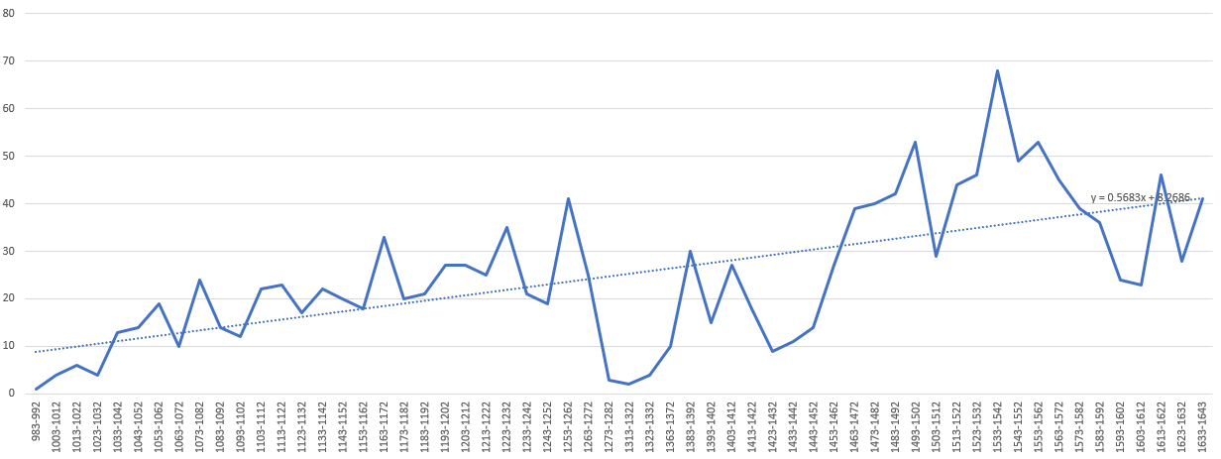
Target
https://github.com/fccsdigitalchina/generative_ai_east_asian_studies/blob/main/Visualization/Linear_line_on_html/1_task.xlsx
y = 0.5683x + 8.2686

Slide 76
Prompt: Generate Linear Regression Algorithm
Can you use JS to generate the linear regression algorithm?
When ChatGPT can’t generate correct algorithm or can’t use math libraries correctly

Slide 77
Prompt: Describe Visualization Details
Please provide a single HTML file with inline CSS and JavaScript for a webpage that meets the following suggestions:
1. Create a line chart using the following data, where the "x_label" are the labels on the x-axis and the y_value is on the y-axis:
x_value x_lable y_value
2. Calculate the linear regression function for the given list using the function you just generated. Overlay the regression line on the line chart.

Slide 78
Prompt: Output Important Results for Check
3. Display the regression function, n, x_sum, y_sum, xx_sum, xy_sum on the page.

Slide 79
Prompt: How to cite JavaScript Libaries
4. Provide the necessary library citations or links to external resources used in the code, specifically from CDN sources.

Slide 80
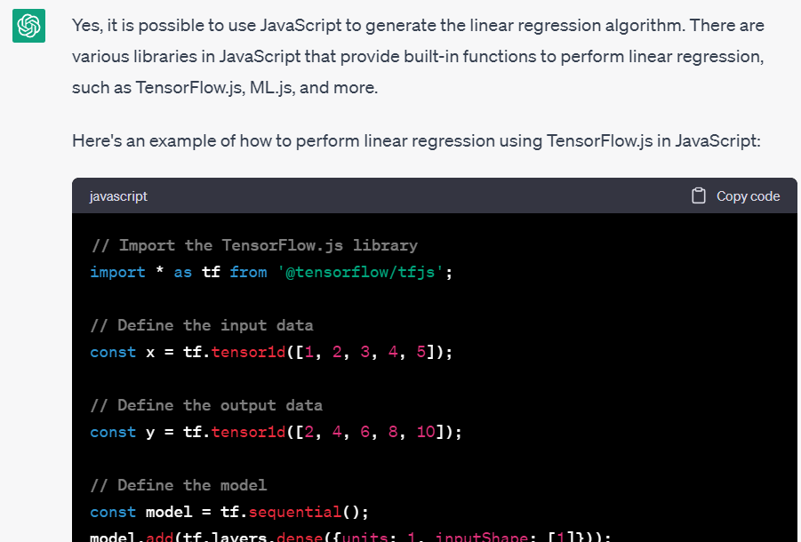
https://github.com/fccsdigitalchina/generative_ai_east_asian_studies/blob/main/Visualization/Linear_line_on_html/2_prompt_correct_part_1.txt

Slide 81
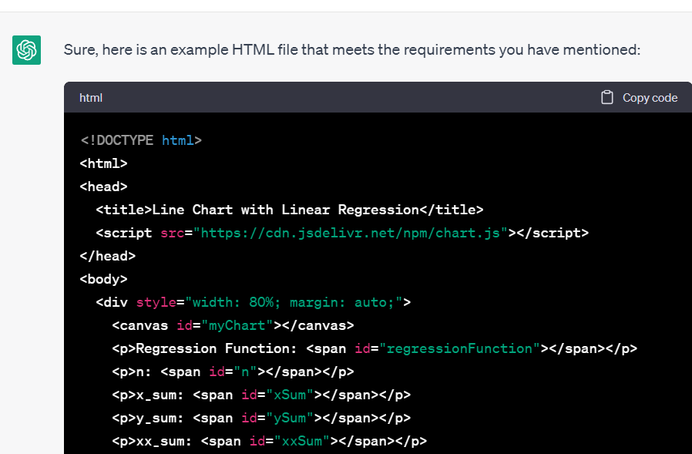
https://github.com/fccsdigitalchina/generative_ai_east_asian_studies/blob/main/Visualization/Linear_line_on_html/2_prompt_correct_part_2.txt

Slide 82
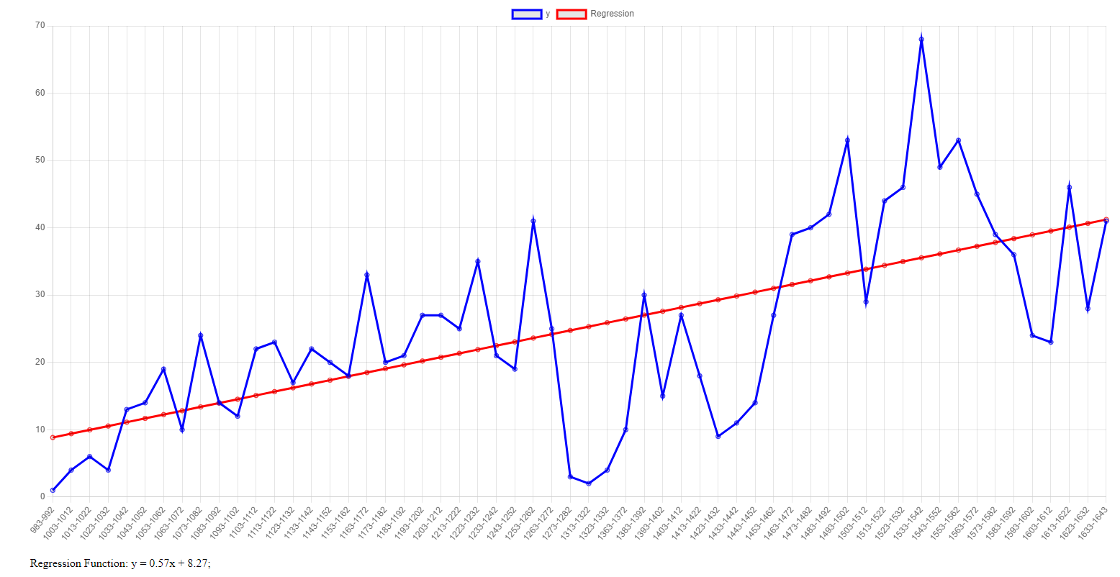

Slide 83
Social Network Analysis (Gephi)
Nodes
1 王安石
2 朱熹
3 蘇軾
4 蘇轍
5 蘇洵
6 呂祖謙
7 黃庭堅
8 呂大臨
Edges
1 2
2 3
3 4
4 1
1 3
2 4
5 1
6 2
7 3
8 4

Slide 84
Prompt: Describe the Input and Output
Please create a gephi input (gexf) for me by using these as nodes:
[Nodes list]
and these as edges:
[Edges list]

Slide 85
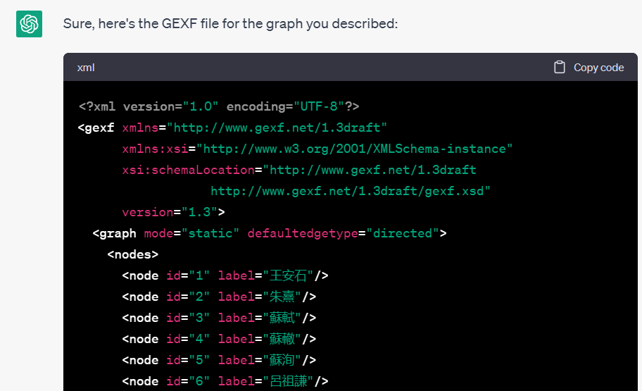
https://github.com/fccsdigitalchina/generative_ai_east_asian_studies/blob/main/Visualization/Gephi_create_gexf/2_prompt.txt

Slide 86
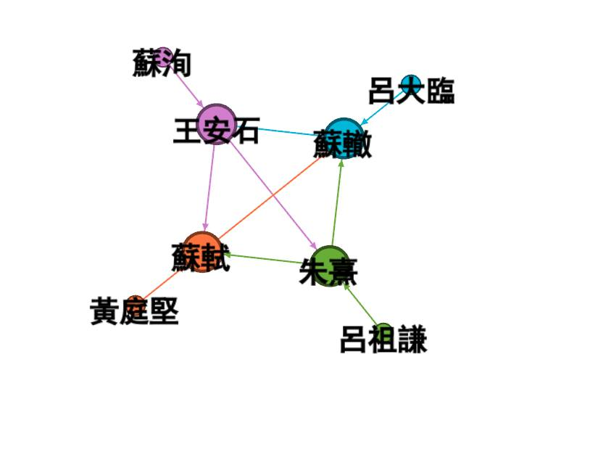
https://github.com/fccsdigitalchina/generative_ai_east_asian_studies/blob/main/Visualization/Gephi_create_gexf/3_output.gexf

Slide 87
Data Summarization

Slide 88
Try to Understand Generative AI

Slide 89
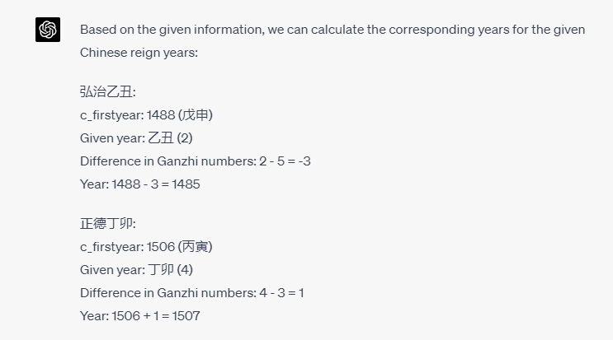
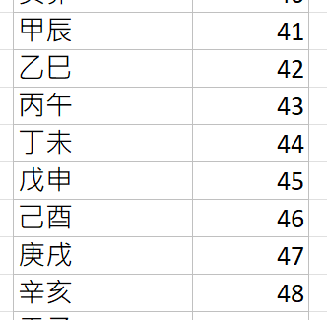
Show Your Ideas Step by Step

Slide 90
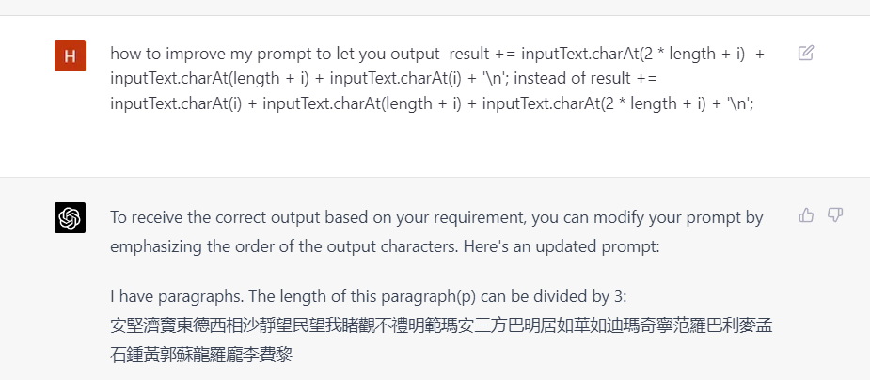

Teach Yourself

Slide 91
Basic ideas
Interact with AI
A good prompt for determinate knowledge will generate a stable output
Start a new chat for a new experiment
Try to understand the result instead of trusting the result
More information is good, more logic is bad
Biased examples will give biased result

Slide 92
Speeches from Generative AIs

